Slide 1
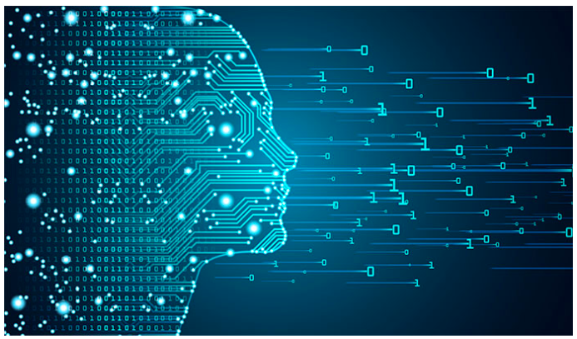
Deep Learning
Dee
Session -8: CNN

Slide 2
Agenda
Revision of CNN
Parameters in CNN
Transfer Learning
Transfer learning using pre-trained models
Important pre-trained models
Implementation
Conclusion

Slide 3
Convolutional Neural Network

Slide 4
Concept of filter

Slide 5
Convolution ?

Slide 6
Layers in CNN
Input layer
Convolution layer
Pooling layer
Flatten layer
Dense /Output layers

Slide 7
https://poloclub.github.io/cnn-explainer/

Slide 8
Input layer
Input image shape =(height, width, depth/channels); channels = 3, for RGB and =1 for gray scale images.

Slide 9
Convolution layer
Input: (h, w, c)
Kernel
Product of output of earlier layer and kernel
Output: (h,w,c), c is controlled by first argument given in the layer.
Convolution vs densely connected layer: Learning local vs global patterns.

Slide 10
Feature map
Feature map: Is a response to each of the filters.
(height, width, depth) => depth is the no of filters/features.
Convolution is defined by two parameters:
No of filters, Filter size.

Slide 11
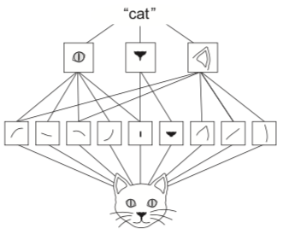
Importance of Convolution
Patterns they learn are translation invariant
Learn spatial hierarchies

Slide 12
Pooling layer
Consolidates
Different types of pooling:
Max Pool
Average Pool

Slide 13
Parameters of Convolution layer
Filters
Kernel size: 3 / (3,3)
Strides: 1 / (1,1)
Padding: valid =No padding; same = Padding with zeros
Activation:
Kernel/ Bias Initializer: Matrix initializers
Kernel/bias/activity regularizer: L1, L2,L1L2,

Slide 14
Parameters of Maxpool layer
Pool size: 2 / (2,2)
Strides
Padding

Slide 15
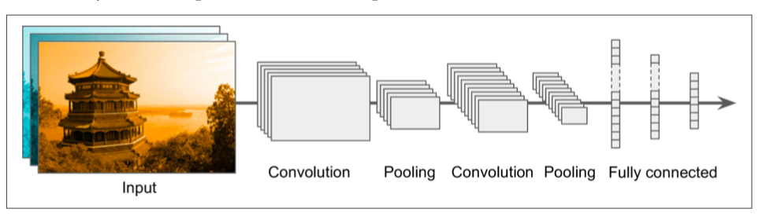
CNN Architectures

Slide 16
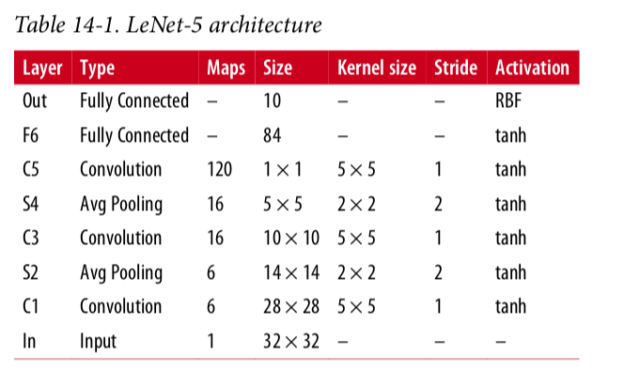
LeNet

Slide 17
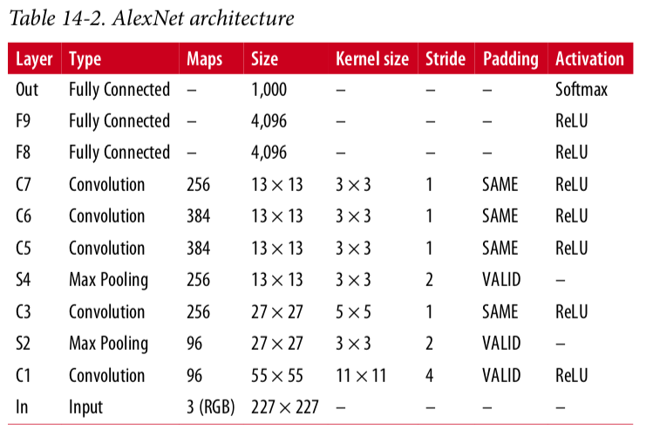
AlexNet

Slide 18
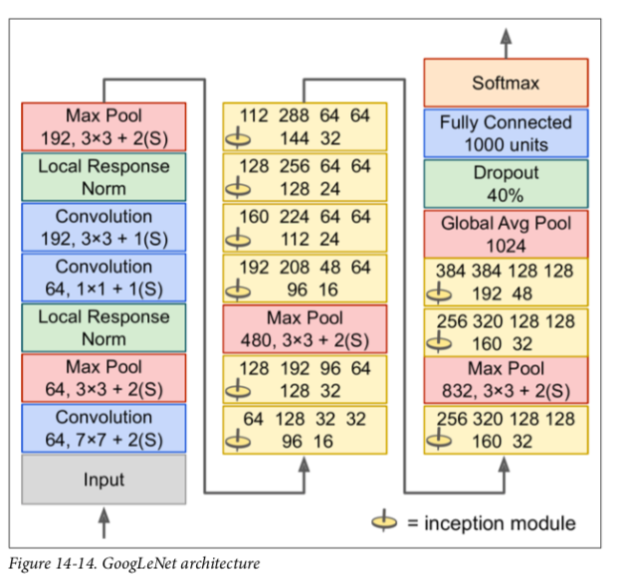
GoogleNet

Slide 19
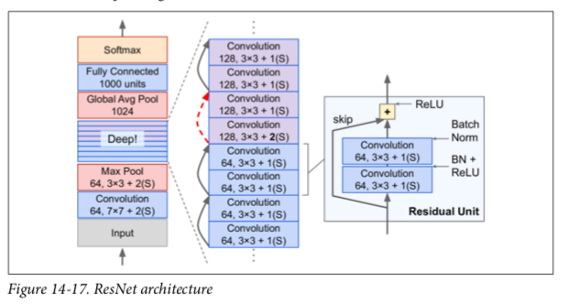
ResNet

Slide 20
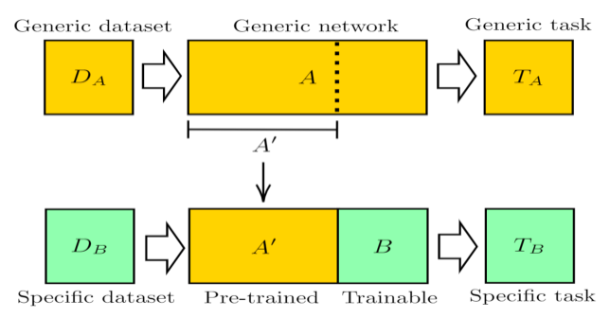
Transfer Learning
Applying knowledge gained from another problem in a new problem.
Transfer learning through pre-trained models

Slide 21
Pre trained models for computer vision
VGG19
Inceptionv3
Resnet50
EfficientNet

Slide 22
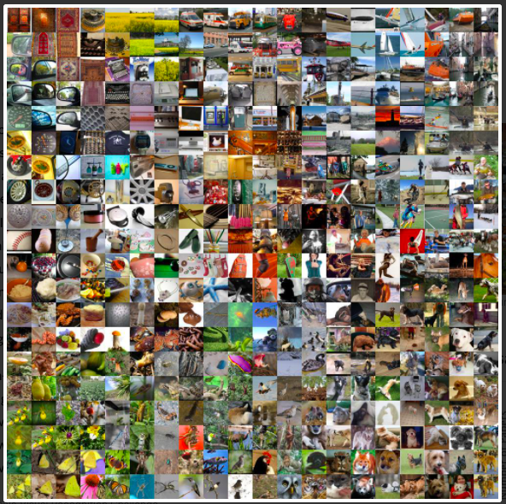
ImageNet dataset
15 million images
Each object with around 1000 different images.
A benchmark dataset for checking the effectiveness of the model.
ImageNet Large Scale Visual recognition Challenge (ILSVRC)

Slide 23
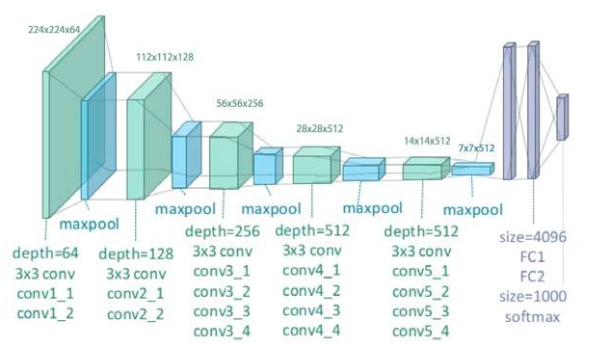
VGG19

Slide 24
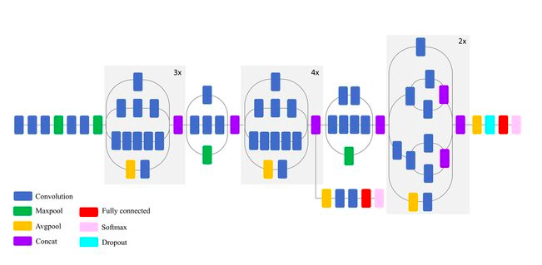
Inceptionv3

Slide 25
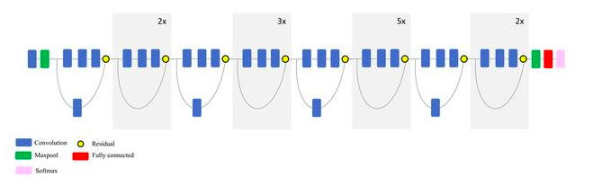
Resnet50

Slide 26
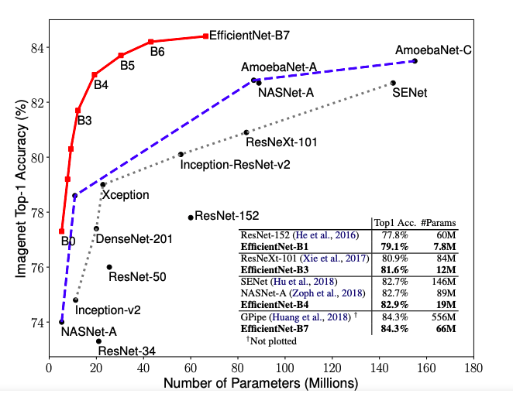
Efficient Net

Slide 27
Comparison of important pre-trained models
https://keras.io/api/applications/
https://www.tensorflow.org/hub

Slide 28
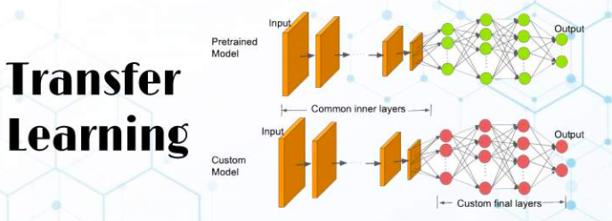
Implementation

